Slide 1


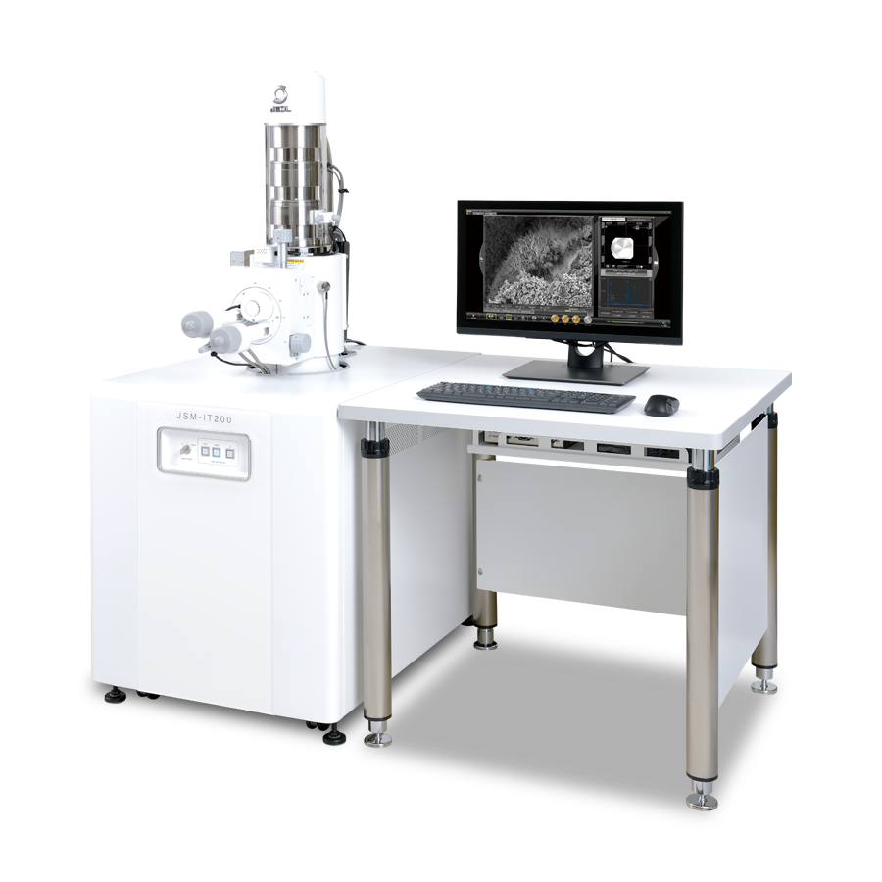
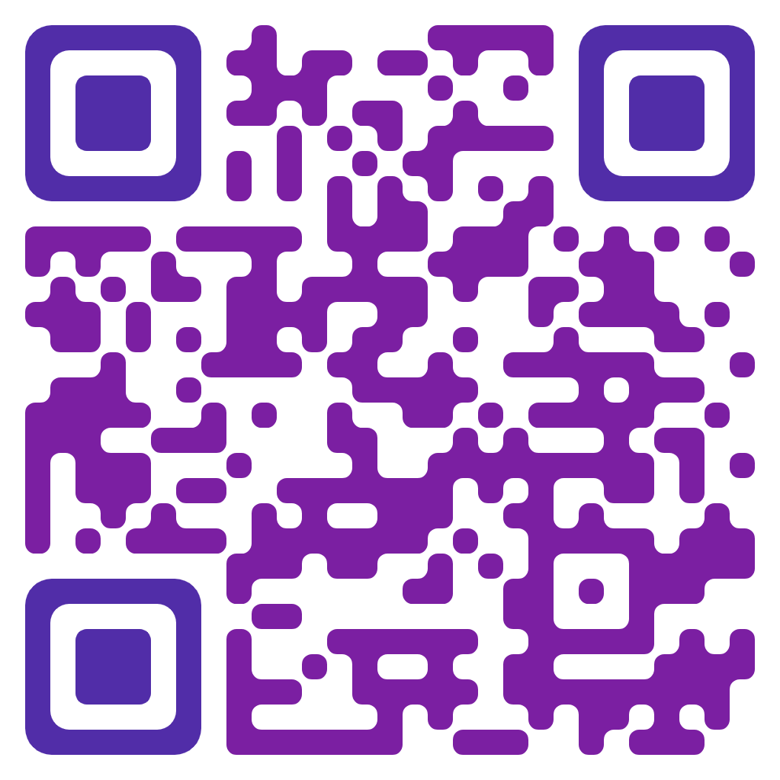
Hands-on Training and Workshop on
Scanning Electron Microscope (SEM)
^{April 22nd – 26th, 2024}
^{In daily batches of 20-25}
^{For registration and}
^{more details please visit}
^{Do you want to:}
Gain expertise in using a Scanning Electron Microscope (SEM)?
Learn about sample preparation techniques for SEM analysis?
Capture high-resolution images of your samples?
^{This workshop is for you!}
First come shall be first served
This hands-on workshop will provide participants with:
^{Theoretical foundation of SEM}
In-depth knowledge of SEM operation
Practical training on sample preparation and image acquisition
Techniques for data analysis and interpretation
For more details:
Department of Pharmaceutical Technology
(NBA accredited and DST-FIST supported) &
Centre for Excellence in Nanobio Translational Research (Auto)
UCE-AU-BIT Campus, Tiruchirappalli, TN, IN.
Email: sempharmatech@gmail.com| Mob. 9842478785

