Slide 1
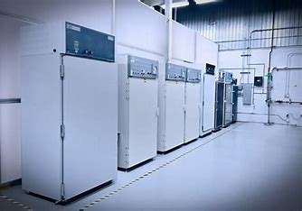


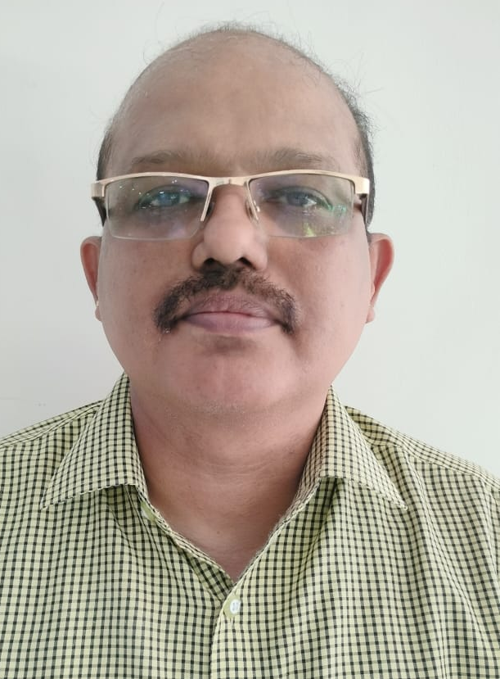
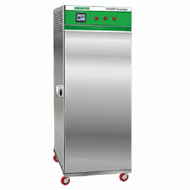
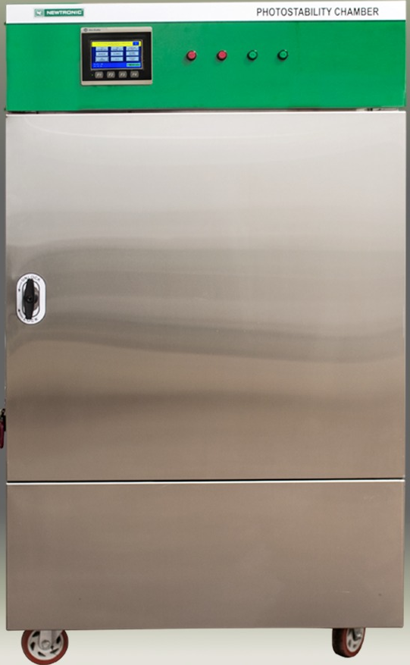

UNIVERSITY COLLEGE OF ENGINEERING
ANNA UNIVERSITY-BIT CAMPUS
TIRUCHIRAPPALLI-620024
Department of Pharmaceutical Technology
(DST-FIST Supported)
&
B.Tech Pharmaceutical Technology (NBA accredited)
organizes
EXPERIENTIAL LEARNING ON STABILITY & PHOTOSTABILITY CHAMBER
K. Shriram
General Manager
Saksham Technologies
Chennai
02-05-2024
B-217 A.P.J Abdul Kalam Auditorium
Organized by:
Dr. A. Umamaheswari
Department of Pharmaceutical Technology,
Anna University-BIT Campus, Tiruchirappalli-620 024

